Slide 1
Properties of Waves

Slide 2
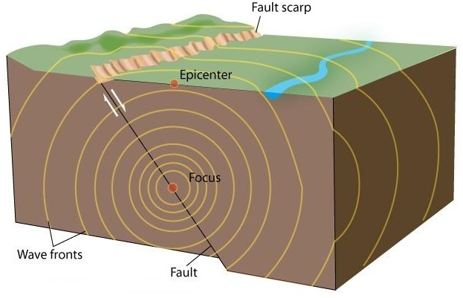
What are Waves?
Waves are travelling disturbances that transport energy from one location to another without transporting matter.
Examples:
Ripples on the surface of water
Vibration in a guitar string
Electromagnetic waves – light, radio waves, x-rays, microwaves, IR, UV
Seismic waves from earthquakes

Slide 3
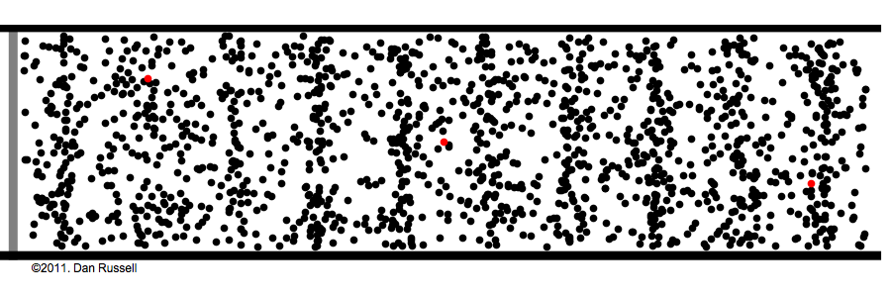
Types of Waves
Electromagnetic waves are the only waves that can travel through a vacuum (empty space).
All other waves require a medium (a substance to travel through) and are called mechanical waves.
Mechanical waves can travel very large distances, but the individual particles in the medium never move far from their original positions.

Slide 4
Transverse Waves
Mechanical waves are classified as transverse or longitudinal based on the motion of the particles involved.
In a transverse wave, particles in the medium vibrate perpendicular to the direction the wave is travelling.
When the particles are displaced upwards from their resting position, they reach a maximum positive displacement called a crest or peak.
Particles pushed below their resting position fall to a maximum negative position called a trough.
Particle motion
Wave direction
A displacement-distance graph shows the displacement of all particles along the length of a transverse wave at a particular point in time.
Displacement
Distance from source

Slide 5
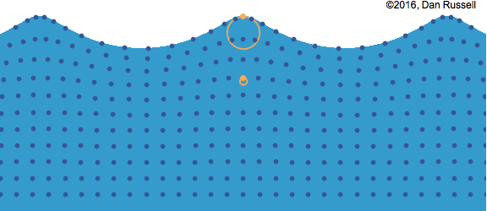
Transverse Waves
Fun fact: waves and ripples in water might look like transverse waves, but they’re actually a little more complicated…

Slide 6
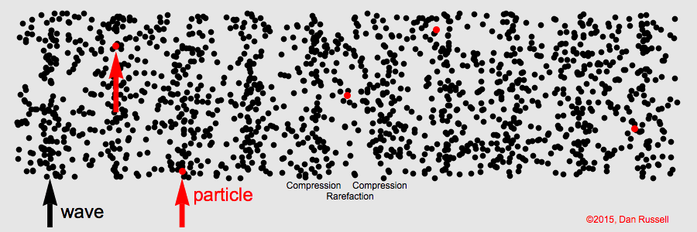
Longitudinal Waves
Mechanical waves are classified as transverse or longitudinal based on the motion of the particles involved.
In a longitudinal wave, particles in the medium vibrate parallel to the direction the wave is travelling.
As the wave travels, it creates regions of high pressure (compression) and low pressure (rarefaction) in the medium.

Slide 7
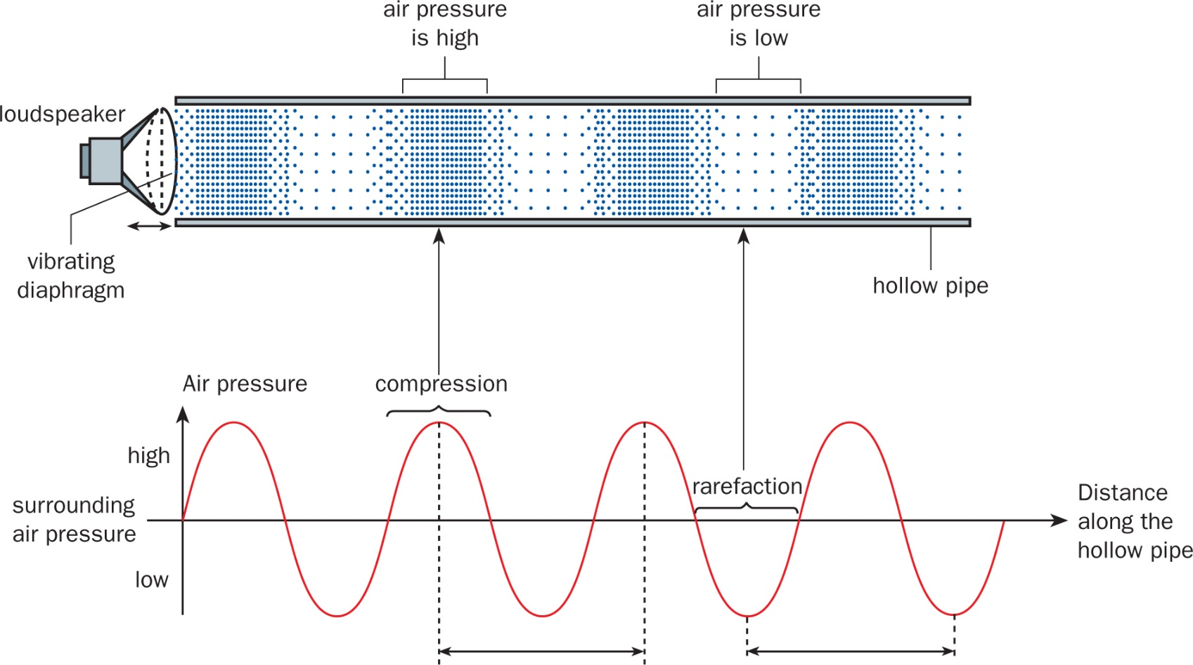
Longitudinal Waves
Watch out!
Longitudinal waves (especially sound waves) are often represented using graphs that look a lot like the displacement-distance graphs used for transverse waves. Don’t be fooled: these graphs are showing changes in pressure, not vertical motion of the particles!

Slide 8
Wave Properties
Key features of waves are:
Amplitude
Wavelength
Frequency
Period
Speed

Slide 9
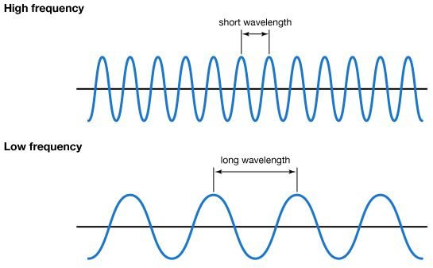
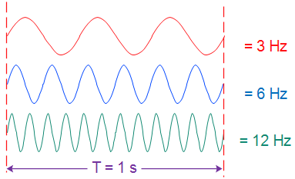
Wave Properties
Amplitude (A) – the maximum displacement of the particles in the medium from their resting positions. Measured in metres.
Wavelength (λ) – the distance over which the wave’s shape repeats (e.g. the distance between two peaks or two troughs). Measured in metres.
Frequency (f) – the number of wave cycles per second. Measured in hertz (Hz); 1 Hz = 1 s⁻¹.

Slide 10
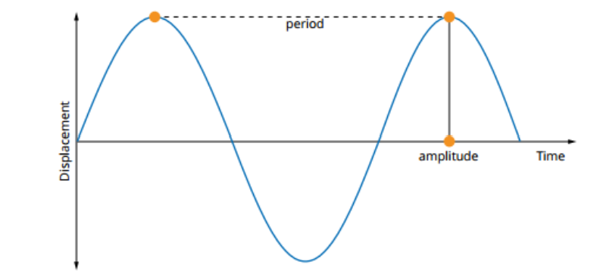
Wave Properties
Displacement-time graphs track the position of one particle as the wave moves through it.
Period (T) – the amount of time it takes for one complete wavelength to pass a specified point. Measured in seconds.
Frequency is the inverse of period:
$T=\frac{1}{f}$
$f=\frac{1}{T}$

Slide 11
Wave Properties
To determine velocity (v) in m s⁻¹:
Generally,
$$v=\frac{s}{t} \text{(}\text{i}\text{.}\text{e}\text{. }\text{velocity}=\frac{\text{displacement}}{\text{time}})$$
For waves,
$$s=λ t=T \text{(}\text{i}\text{.}\text{e}\text{. }\text{displacement}=\text{wavelength}, \text{time}=\text{period})$$
So:
$$v=\frac{λ}{T}$$
$f=\frac{1}{T}$, so:
$$v=fλ$$

Slide 12
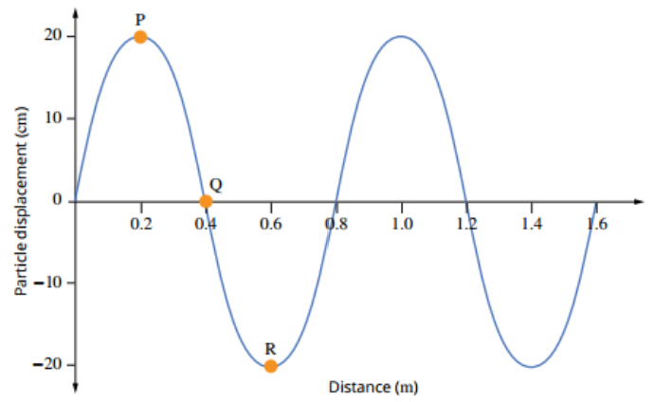
Example #1
Use the displacement-distance graph below to determine the amplitude and wavelength of the wave.

Slide 13
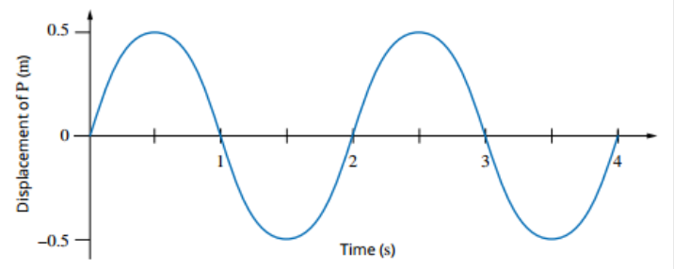
Example #2
Use the displacement-time graph below to determine the frequency, period and amplitude of the wave.

Slide 14
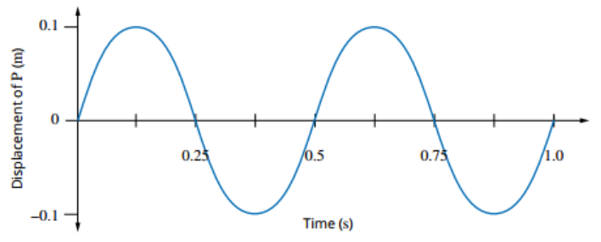
Example #3
The displacement-time graph below shows the motion of a single part of a rope as a wave passes travelling to the right. Use the graph to find the amplitude, period, and frequency of the wave.

